Slide 1
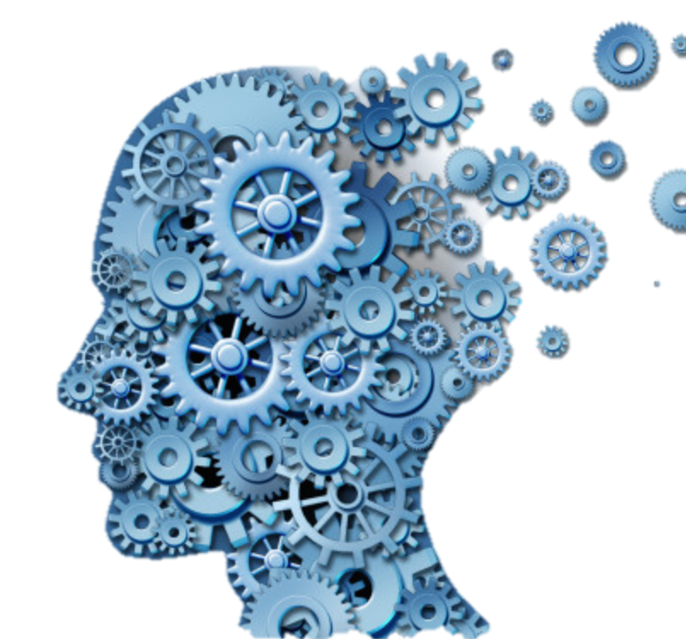
Question Answering System
By
Pruthvij Thakar | Tushar Goel

Slide 2
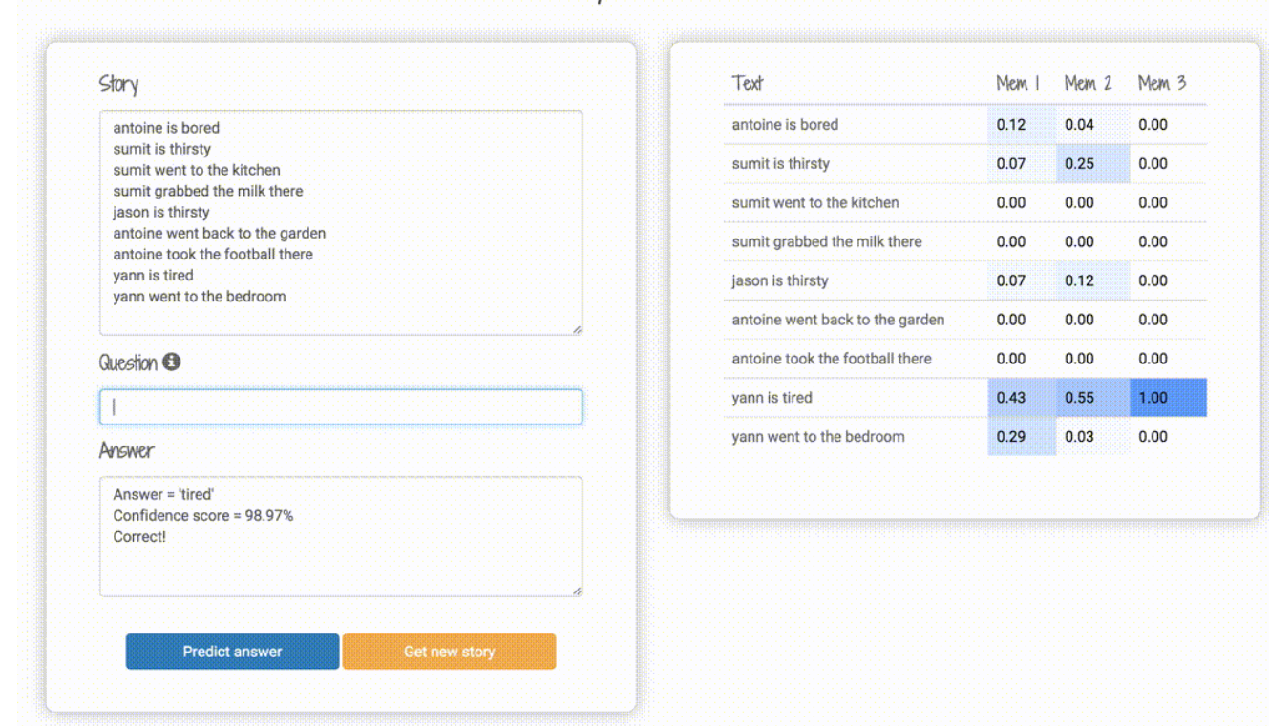
Building Question Answering(QA) system given a machine comprehension

Slide 3
Machine Comprehension is a fundamental problem in Natural Language. There
are many datasets which provide wide range of corpus for this task.
We intend to explore the most recently released dataset, the Babi Dataset developed by Facebook AI research(FAIR), which offers a large number of real crowdsourced questions and passages. We try to explore a number of approaches to this task, Memory Networks(MemNets) for the task of machine comprehension.
Our main goal is to improve the scalability of the models by targeting the sparsity of the learned networks in an attempt to reduce the hypothesis space of our model, while trying to minimize loss of accuracy.

Slide 4
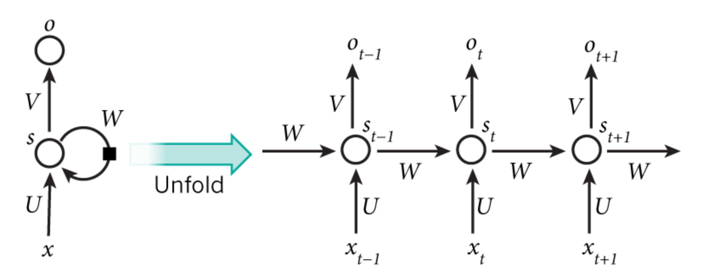
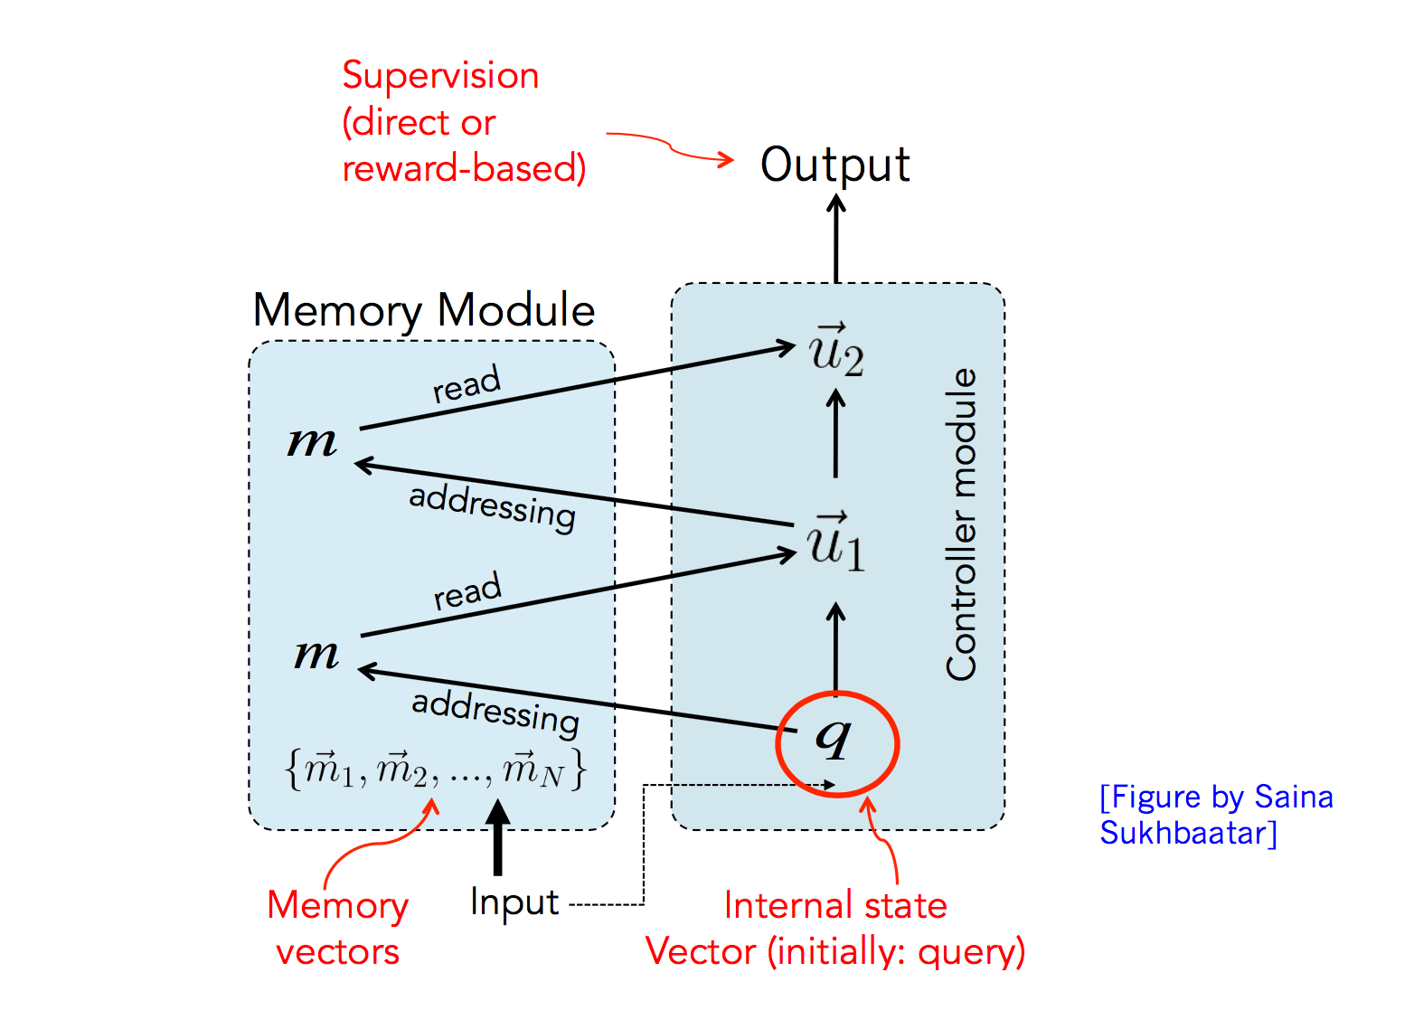
Memory Networks
RNN
RNNs have a “memory” which captures information about what has been calculated so far.
Disadvantage:
they are limited to looking back only a few steps
Memory networks reason with inference components combined with a long-term memory component
[Jason Weston, Sumit Chopra and Antone Bordes]. 2015. Memory Networks. arXiv:1410.3916

Slide 5
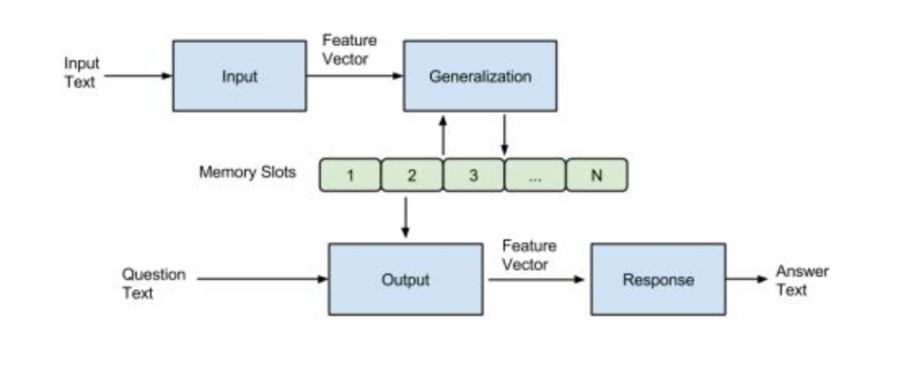
4 steps of MemNN implementation:
I(input): this converts incoming data to the internal feature representation.
G(generatlization): this updates memories given new input
O (output): this produces new output (in feature representation space) given the memories.
R (response): converts output O into a response seen by the outside world.
I (input): converts to word embeddings X(dialog).
G (generalization): stores x in next available slot Mn()
O (output): Loops over all memories k=1 or 2 times:
1st loop max: finds best match Mi with X(question).
2nd loop max: finds best match Mj with (x, Mi)
The output o is represented with (x, Mi, Mj).
R (response): ranks all words in the dictionary given O and returns best single word. (OR: use a full RNN here)

Slide 6
Architecture of Application
Data Processing & Cleaning
Feature Vector Generation
Building Memory Network Model
Training & Testing Model
Validation of Model
Evaluating the Model
Deployment of Model

Slide 7
References
1. Jason Weston, Sumit Chopra and Antone Bordes. 2015. Memory Networks. arXiv:1410.3916.
2. Sainbayar Sukhbaatar, Arthur Szlam, Jason Weston and Rob Fergus. 2015. End-To-End Memory Networks. Advances in Neural Information Processing Systems (NIPS) 28.
3. Eylon Stroh, Priyank Mathur. 2016. Question Answering Using Deep Learning.
http://brandonrose.org/ner2sna#Entity-Extraction-with-Core-NLP-Server
http://brandonrose.org/clustering

Slide 8
Thank you !!!

